Slide 1
To-Go ER Diagrams

Slide 2
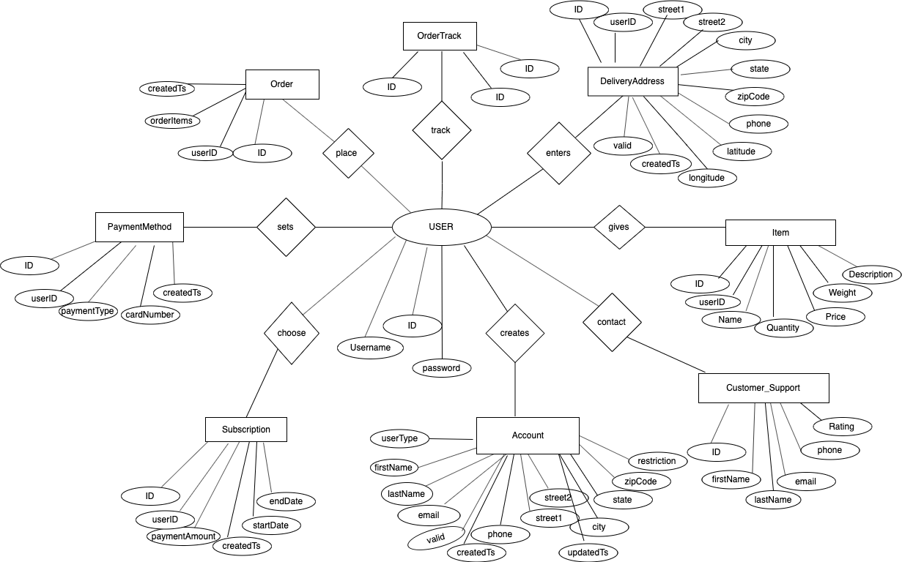
To-Go
CONCEPTUAL ER DIAGRAM
User

Slide 3
To-Go Logical ER Diagram
I1 & I2 Scope
ITEM
PK – ID : INTEGER FK – userID : INTEGER Name: Quantity Price: DOUBLE Weight: DOUBLE Description: VARCHAR
USER
PK – ID : INTEGER UserName : VARCHAR Password : VARCHAR
N
N
1
N
N
1
ACCOUNT
PK – accountID : INTEGER FK – userID: INTEGER userType: VARCHAR firstName: VARCHAR lastName: VARCHAR Email: VARCHAR Phone: VARCHAR Street1: VARCHAR Street2: VARCHAR City: VARCHAR State: VARCHAR Zipcode: INTEGER createdTs: TIMESTAMP UpdatedTs: TIMESTAMP Restriction: TEXT Valid: TINYINT
PICKUP ADDRESS
PK – ID : INTEGER FK - userID : INTEGER street1: VARCHAR street2 : VARCHAR City: VARCHAR State: VARCHAR ZipCode: INTEGER Phone: VARCHAR createdTs: TIMESTAMP Valid: TINYINT
1
1
DELIVERY ADDRESS
PK – ID : INTEGER FK - userID : INTEGER street1: VARCHAR street2 : VARCHAR City: VARCHAR State: VARCHAR ZipCode: INTEGER Phone: VARCHAR createdTs: TIMESTAMP Valid: TINYINT

